Slide 1
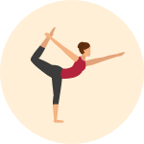
Skeletal Insights
Posture Recognition of Yoga Poses
Shahbaz Chaudhary
Emily Coppess
Jay Ong

Slide 2
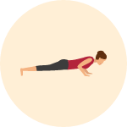
Agenda
1. Executive Summary
2. Problem Statement
3. Research Purpose
4. Objectives
5. Data Description
6. Methodology
7. Expected Results
Summary
Problem
Purpose
Data
Methodology
Outcomes
Notes:
Shahbaz

Slide 3

Executive Summary
Overall Goal: Our goal is to ultimately build a tool that would enable Yoga beginners to learn and practice in an informal, inexpensive setting.
Capstone Goal:
We will use public data to extract joint angles from images
We will create our own labeled data to classify Yoga poses from joint angles
Summary
Problem
Purpose
Data
Methodology
Outcomes
Notes:
Shahbaz
Summarize this presentation: We want to build an automated yoga instructor. We will do video to pose info and pose info to yoga classification

Slide 4

Problem Statement
Our primary mission is to introduce yoga to millions of individuals and households. To solve the issue of lack of access to traditional training facilities, we would like to create a cheap and efficient way for anybody to have access to yoga training. Our solution would stream in images from a self-recorded yoga session and recognize the series of yoga poses performed. While our main focus is on assisting beginning yoga users, we would eventually like to create a tool which could be utilized by all levels of yoga users by helping users to not only make sure that they are making the correct poses, but also help them set and realize personal fitness goals.
Summary
Problem
Purpose
Data
Methodology
Outcomes
Notes:
Shahbaz
Mention advances in computer vision as background for Yoga detection, don’t start out with it.
A lot of people want to do yoga, this tool removes some of the barriers: no need to pay a trainer, not be judged, no yoga studios

Slide 5
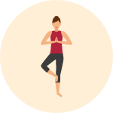
Research Purpose
“Thirty-four percent of Americans,or 80 million people, say they are likely to try yoga for the first time over the next 12 months.” (Yoga in America Study, 2016)
Summary
Problem
Purpose
Data
Methodology
Outcomes
Notes:
Jay
Will ask the audience to consider the impact and potential of introducing yoga to the American public.
We want to convert yoga talkers into yoga doers

Slide 6
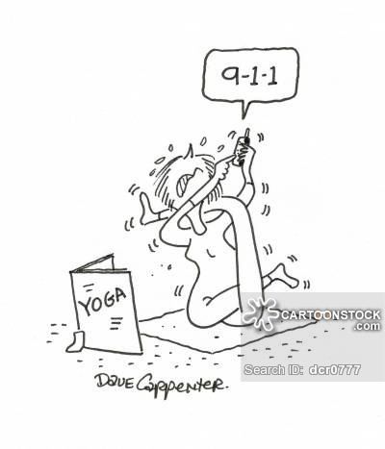
Research Purpose
Remove Obstacles/Barriers for aspiring yoga practitioners.
i.e. Too Busy, Yoga is Expensive, Yoga is Intimidating
Summary
Problem
Purpose
Data
Methodology
Outcomes
Notes:
Jay
Remember, we want to convert yoga talkers into doers so the first thing we need to do is to remove the potential obstacles/ pain-points. \
What are the pain points?
(1)Busy life
(2)Expensive
(3)Intimidating
WIll explain our research purpose hierachically from Removing Obstacles to Needs to Solution to Platform/Community.

Slide 7
Research Purpose
Remove Obstacles/Barriers for aspiring yoga practitioners.
A Convenient, Cheap and Personal way to learn yoga.
Summary
Problem
Purpose
Data
Methodology
Outcomes
Notes:
Jay
Remember, we want to convert yoga talkers into doers so the first thing we need to do is to remove the potential obstacles/ pain-points. \
What are the pain points?
(1)Busy life
(2)Expensive
(3)Intimidating
WIll explain our research purpose hierachically from Removing Obstacles to Needs to Solution to Platform/Community.

Slide 8
Research Purpose
Remove Obstacles/Barriers for aspiring yoga practitioners.
A Convenient, Cheap and Personal way to learn yoga.
An Application that converts images to feedback to beginners.
Our Capstone Scope : assist beginning yoga practitioners
Summary
Problem
Purpose
Data
Methodology
Outcomes
Notes:
Jay
Remember, we want to convert yoga talkers into doers so the first thing we need to do is to remove the potential obstacles/ pain-points. \
What are the pain points?
(1)Busy life
(2)Expensive
(3)Intimidating
WIll explain our research purpose hierachically from Removing Obstacles to Needs to Solution to Platform/Community.

Slide 9
Research Purpose
Remove Obstacles/Barriers for aspiring yoga practitioners.
A Convenient, Cheap and Personal way to learn yoga.
An Application that converts images to feedback to beginners.
Our Capstone Scope : Beginner Yoga Pose Identification
A Platform for health living = yoga + supportive community.
Summary
Problem
Purpose
Data
Methodology
Outcomes
Notes:
Jay
Remember, we want to convert yoga talkers into doers so the first thing we need to do is to remove the potential obstacles/ pain-points. \
What are the pain points?
(1)Busy life
(2)Expensive
(3)Intimidating
WIll explain our research purpose hierachically from Removing Obstacles to Needs to Solution to Platform/Community.

Slide 10
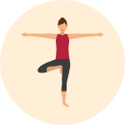
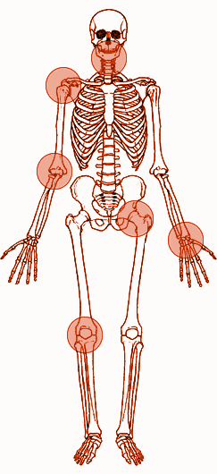
Research Objectives
Recognize 13 major joints on the human body from images: ankle, knee, hip, wrist, elbow, shoulder, neck
Summary
Problem
Purpose
Data
Methodology
Outcomes
Notes:
Jay
Transition: Now that we’ve identified our research purpose, we need to define concrete objectives that we need to achieve …
(1)Extract useful information from image in the form of joint positions
(2)....

Slide 11
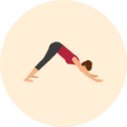
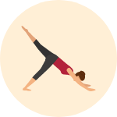
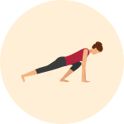
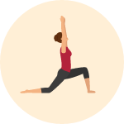

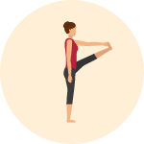
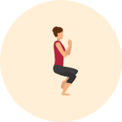
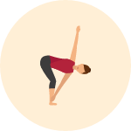
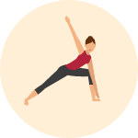
Research Objectives
Recognize 13 major joints on the human body from images: ankle, knee, hip, wrist, elbow, shoulder, neck
Use joint position and angle data to classify 9 poses from a common Yoga flow:
Summary
Problem
Purpose
Data
Methodology
Outcomes
Notes:
Jay
(2)Use joint coordinates as well as transformed variables like joint angles to classify what yoga positions person is doing from static images.

Slide 12
Application Data Model
Image
Neural Net
Joint Coordinates
Users
Feedback
Pose Classification
Joint Angles
Summary
Problem
Purpose
Data
Methodology
Outcomes
Notes:
Jay
After identifying the overarching research purpose and specific research objectives of our project, we went to the drawing board and thought about how data would flow through our hypothetical solution ...

Slide 13
Application Data Model
Capstone
Image
Neural Net
Joint Coordinates
Users
Feedback
Pose Classification
Joint Angles
Summary
Problem
Purpose
Data
Methodology
Outcomes
Notes:
Jay
But basically our capstone will be focused on this part …
(a)By makin sure that existing technology with convolutional NN (with some additional calibration) will give us accurate joint coordinates
(b)By training a classification model that allows for accurate identifcation of a finite number of yoga poses.

Slide 14
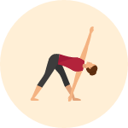
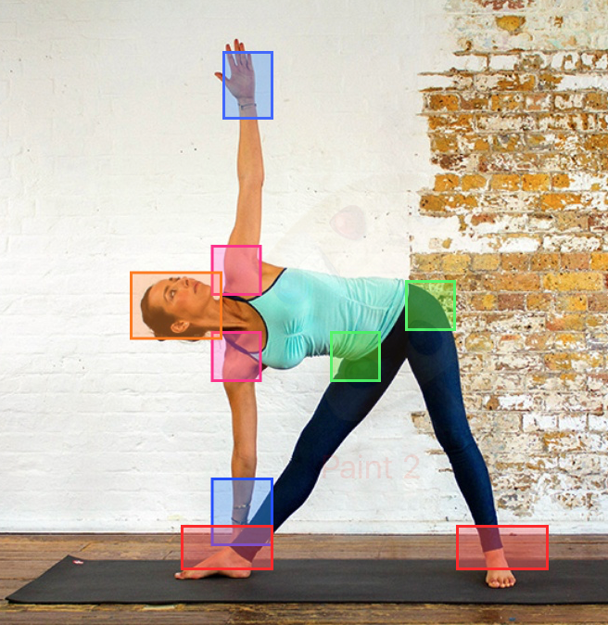
Data Description
Public repositories contain over 35k images (175 GB raw) of human poses with annotated joints:
MPII ~ Max Planck Insitute
LSP ~ Leeds Sport Pose
Data Origin : joints were manually labelled.
Training Set for Deep Learning algorithm combines image-coordinate pairs from MPII and LST.
Training Set for classification model and yoga pose calibration of NN will be generated off of publicly available media.
Summary
Problem
Purpose
Data
Methodology
Outcomes
Notes:
Jay
WIll describe the data we are going to use to train CNN as well as Classification Model

Slide 15
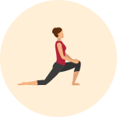
Methodology
Part 1: Skeletal Mapping
We will convert images into vectors of joint locations using Convolutional Neural Networks.
Validation: holdout validation using image-coordination pairings
Image
Neural Net
Joint Coordinates
Summary
Problem
Purpose
Data
Methodology
Outcomes
Notes:
Emily

Slide 16
Methodology
Part 1: Skeletal Mapping
We will convert images into vectors of joint locations using Convolutional Neural Networks.
Model Input: images of individuals (about 150 pixels in length)
Model Output: vector of body part locations
Validation: holdout validation using image-coordination pairings
Summary
Problem
Purpose
Data
Methodology
Outcomes
Notes:
Emily

Slide 17
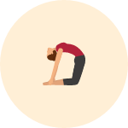
Methodology
Part 1: Skeletal Mapping
We will convert images into vectors of joint locations using Convolutional Neural Networks.
Model Input: images of individuals (about 150 pixels in length)
Model Output: vector of body part locations
Validation: holdout validation using image-coordination pairings
Part 1a: Joint Feature Engineering
Using the derived joint locations, we will calculate joint angles using basic trigonometric principles.
Summary
Problem
Purpose
Data
Methodology
Outcomes
Notes:
Emily

Slide 18
Methodology
Part 2: Pose Classification:
We will build a system using joint angles to identify specific yoga poses.
Validation: k-folds cross-validation
Possible Models: decision trees, random forests, logistic regression
Model Selection Criteria: Accuracy, Runtime
Joint Angles
Pose Classification
Summary
Problem
Purpose
Data
Methodology
Outcomes
Notes:
Emily

Slide 19
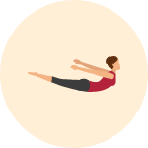
Methodology
Part 2: Pose Classification:
We will build a system using joint angles to identify specific yoga poses.
Model Input: vectors of joint angles
Model Output: yoga pose label
Validation: k-folds cross-validation
Possible Models: decision trees, random forests, logistic regression
Model Selection Criteria: Accuracy, Runtime
Summary
Problem
Purpose
Data
Methodology
Outcomes
Notes:
Emily

Slide 20
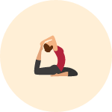
Expected Outcomes
Skeletal Mapping:
Most efficient method will involve adding a yoga specific “calibration” layer to an existing pre-trained neural net.
Our model will create a skeletal description using only 2D information - this should be sufficient to reach an appropriate level of accuracy.
Pose Classification:
A classification tree would provide a pose identification model that would be easy to transform into a feedback system.
Summary
Problem
Purpose
Data
Methodology
Outcomes
Notes:
Emily

Slide 21
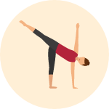
Expected Outcomes
Future Directions:
Transform our static system into a real time system using Markov chains.
Our current system only handles static images.
We could our classification system as a way to label and identify the states for a real time system.
Implications:
Users would be able to undergo personalized remote training programs and be able to track their progress.
Summary
Problem
Purpose
Data
Methodology
Outcomes
Notes:
Emily

Slide 22
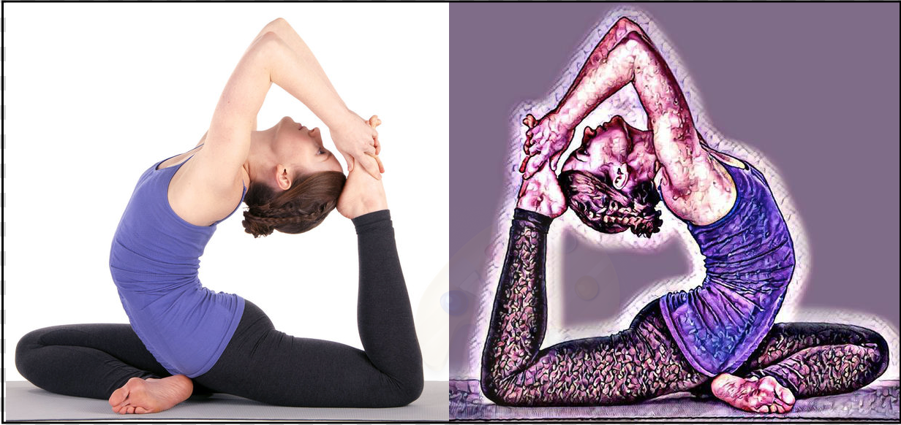
Appendix
Icons made by Roundicons: http://www.flaticon.com/packs/yoga-poses

Slide 23
Proposed Schedule
Implementation:
Summer Quarter:
Week 1-4: Data acquisition, cleaning, and labeling
Week 5-6: Neural Net Training, Building Skeleton Vectors
Week 7: Calculating angles, determining if 2D approach to angles sufficient for classification
Week 8-9: Classification Models - week 8 focusing on model selection
Week 10: Identify metric to use for level of pose correctness
September: Building program to identify pose and level of pose correctness
Writing:
September: Literature Review, Revising/updating Project Proposal sections to be included in final report
Fall Quarter:
Week 1-2: Quantitative Methodology, Analysis of Results
Week 3-4: Conclusions, Recommendations
Week 5-6: Business implications, Future Directions (?)
Week 7: Revisions
Week 8: First Draft of Capstone Presentation
Week 9: Final Draft of Capstone Presentation
Week 10: Capstone Presentation

Slide 24
Real-time pose detection
https://www.youtube.com/watch?v=pW6nZXeWlGM

Slide 25

Yoga Poses
http://templeturmeric.com/movement/primal-warrior-ii-yoga-flow/

